Slide 2

AI assisted numerics for inverse problems in nonlinear transport

Slide 3

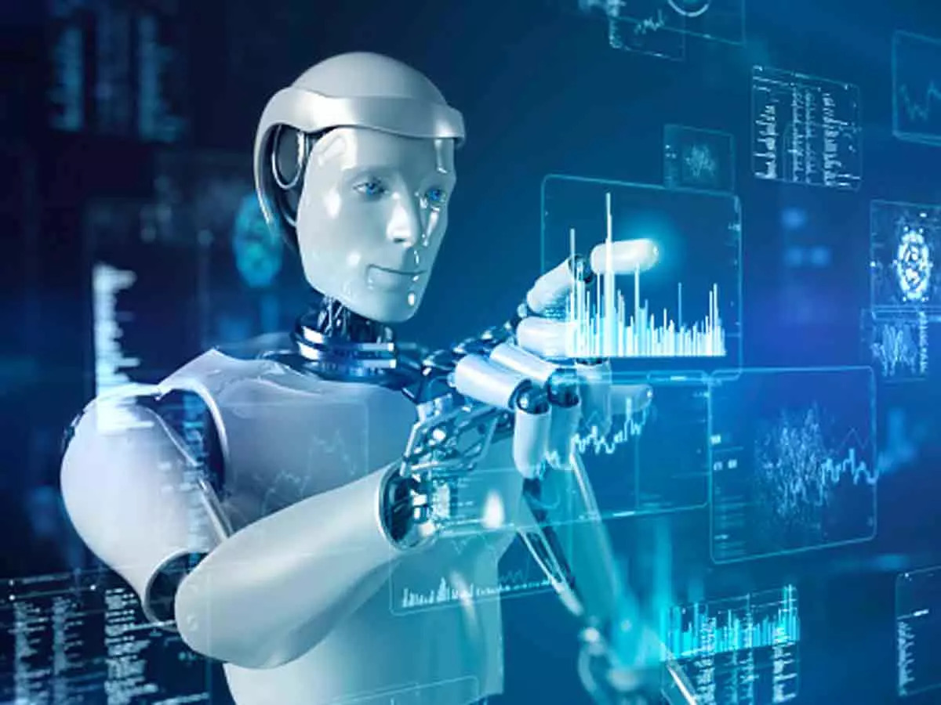
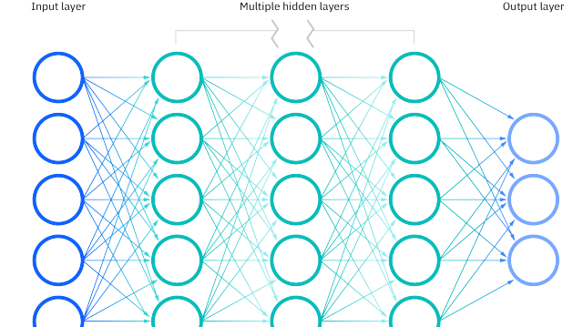
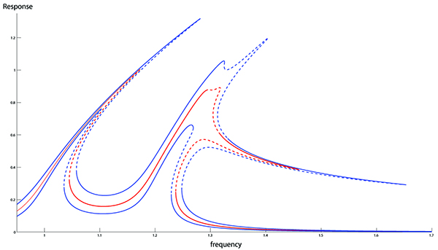
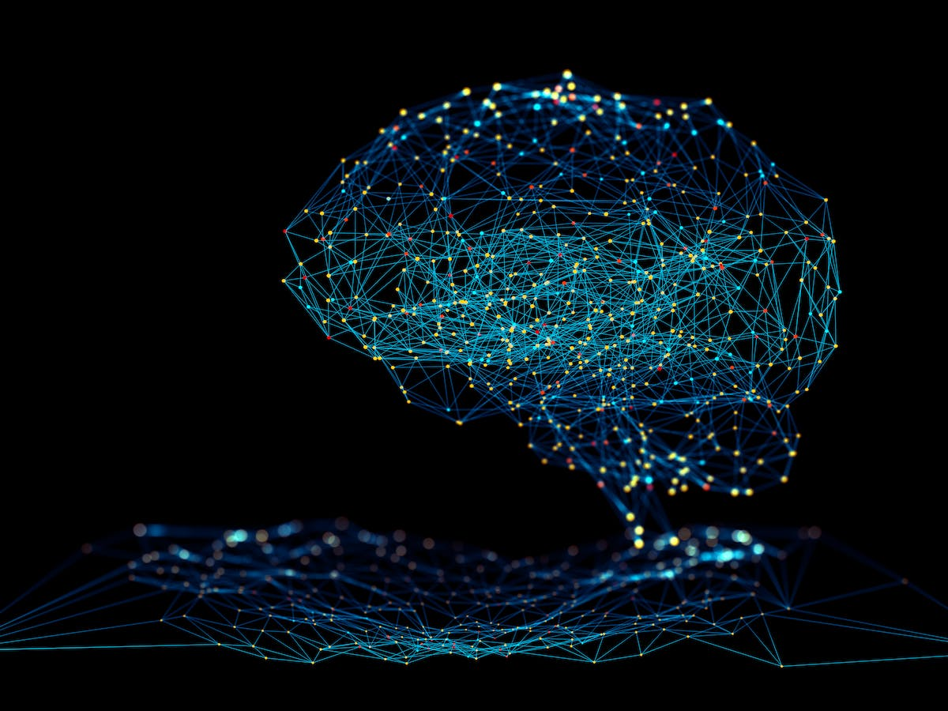

Slide 5
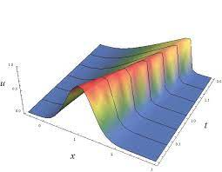
Numerics
All components are known

Slide 6
Observations
Unknown source

Slide 7
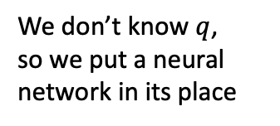
Observations
Unknown source
We don’t know $q$, so we put a neural network in its place
Inverse problem

Slide 8

Observations
Unknown source
We don’t know $q$, so we put a neural network in its place
Inverse problem
Numerics
All operations on $\hat{q}$ are recorded for backpropagation

Slide 9
Observations
Unknown source
We don’t know $q$, so we put a neural network in its place
Inverse problem
Loss
Numerics
All operations on $\hat{q}$ are recorded for backpropagation

Slide 11



Slide 14
What!?

Slide 15
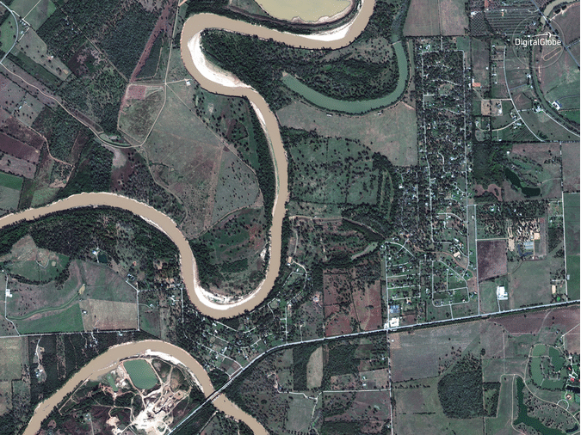
https://www.cbsnews.com/pictures/houston-harvey-floods-before-and-after/

Slide 16
https://www.cbsnews.com/pictures/houston-harvey-floods-before-and-after/

Slide 17
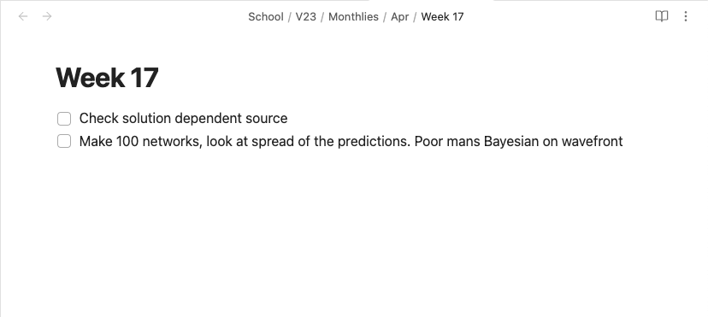
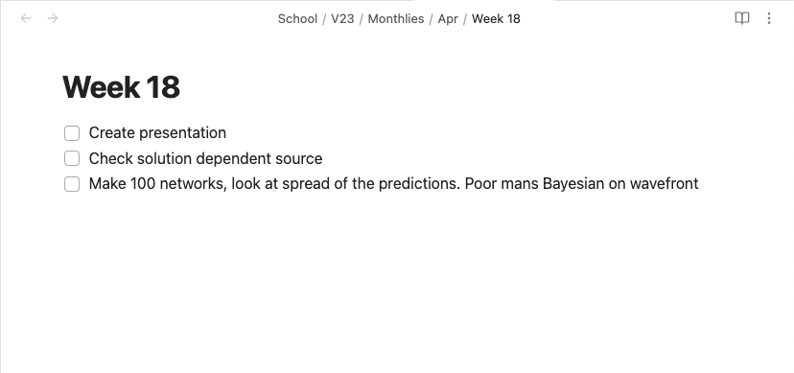

Slide 18


Slide 19





Slide 20
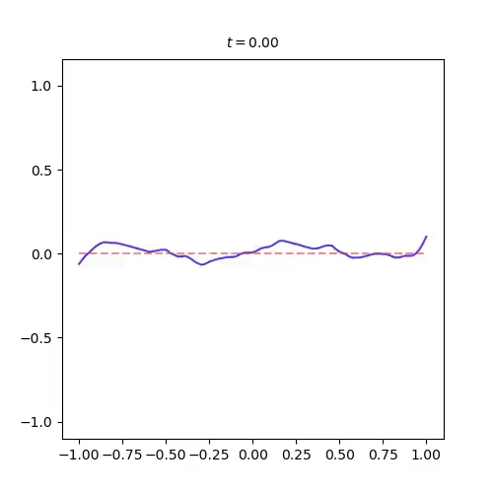

Slide 21




Slide 22
TEORI

Slide 23
TEORI

Slide 24
